Slide 1
Minecraft Introduction & Guide

Slide 2
Contents
What is Minecraft? 3
Installing Minecraft 5
First Time Setup 8
Creating a World 20
Controls 26
Basic Blocks 38
Decoration Blocks 44
Connecting to the Server 53
Using In-Game Chat 60

Slide 3
What is Minecraft

Slide 4
What is Minecraft?
Minecraft is a video game where the world is made of blocks and these blocks can be mined, placed, or used to craft other blocks (hence mine-craft). Minecraft is considered a sandbox game which is a genre of video games that provide tools for players to realise their imagination, similar to how children use sandboxes/sandpits to create fantastical structures and sculptures.

Slide 5
Installing Minecraft

Slide 6
Installing Minecraft
The following instructions are for Windows 10 devices. Some steps may be different if you are using an alternative operating system.
To install Minecraft go to https://www.minecraft.net/en-us/download/ and click on the download button (as shown on the next slide).
This will download an installer than you can click on to install Minecraft. Follow the on-screen instructions, accepting each option as you progress. You may need Admin permission to complete the installation.

Slide 7
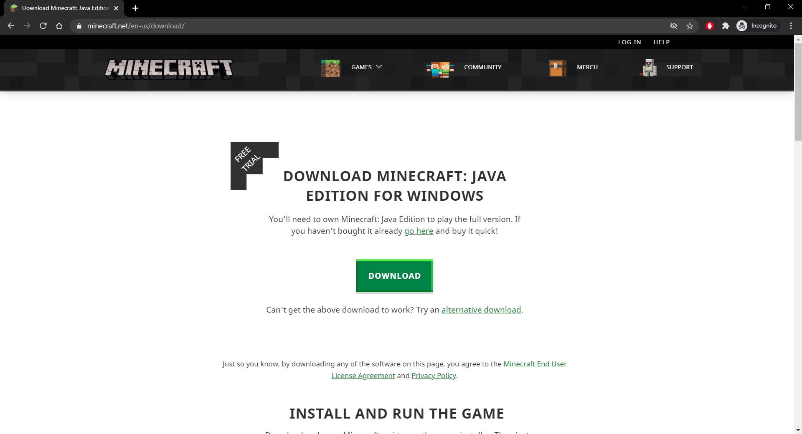
Contents

Slide 8
First Time Setup

Slide 9
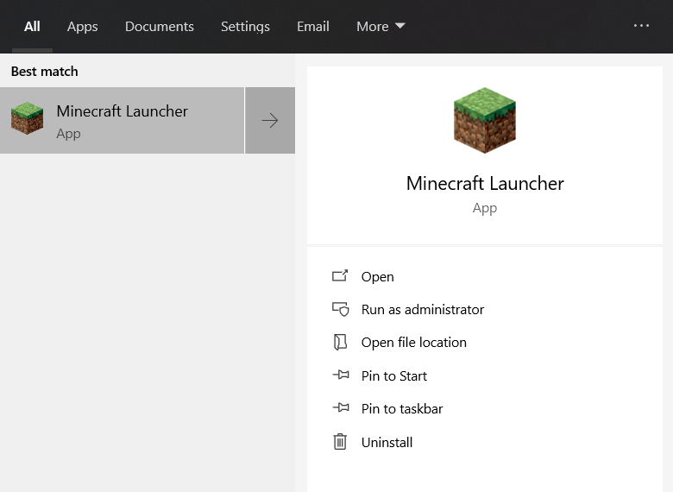
Launching Minecraft
Once you have installed Minecraft you should be able to launch an application called ‘Minecraft Launcher’.
If you are unable to find this application press the windows key  and type ‘Minecraft’. You should see the app appear similar to the image on the right.

Slide 10
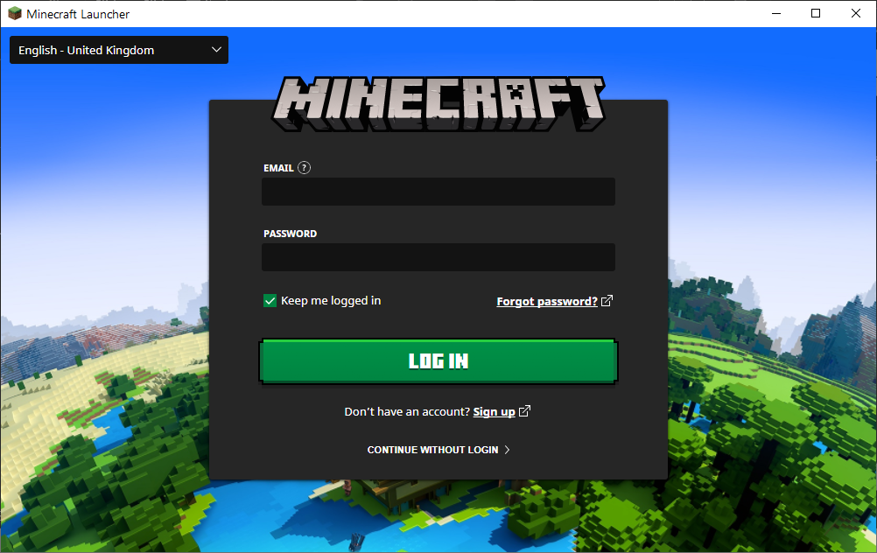
First Time Setup
Once you have launched the application, you will be asked to log in as shown in the image on the right.
Enter your details and press the ‘LOG IN’ button.

Slide 11
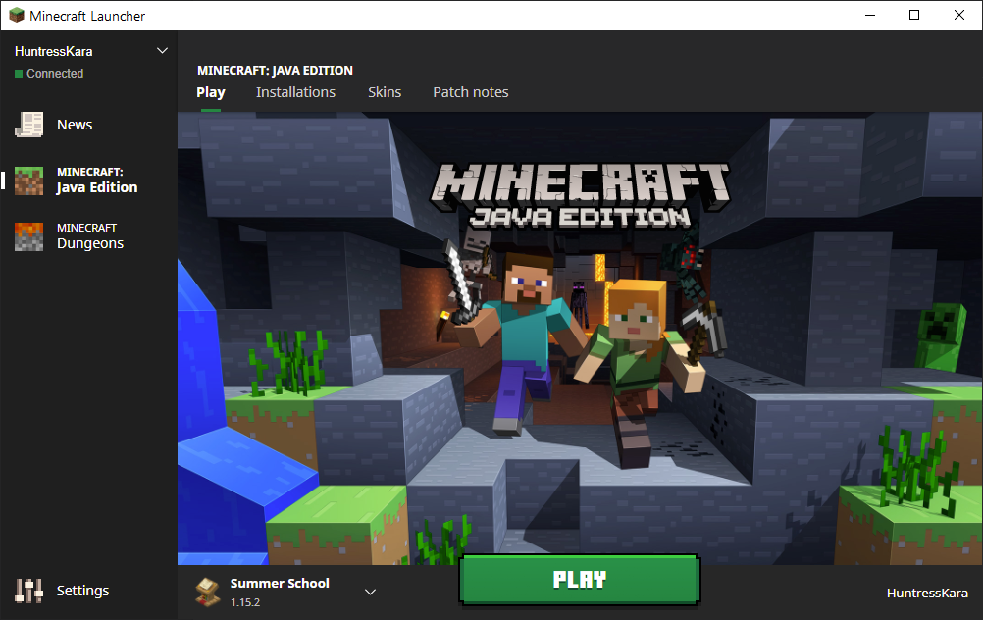
First Time Setup
Once logged in, you should see a window similar to the one on the right.
Click the ‘Installations’ tab and then click on ‘+ New...’ as shown in the following slides.

Slide 13
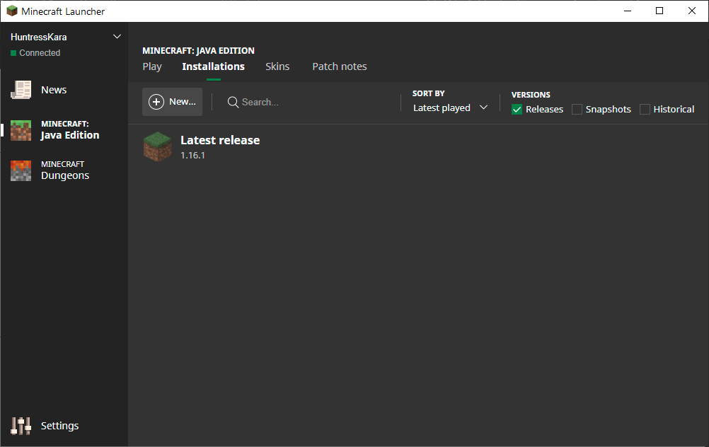

Slide 14
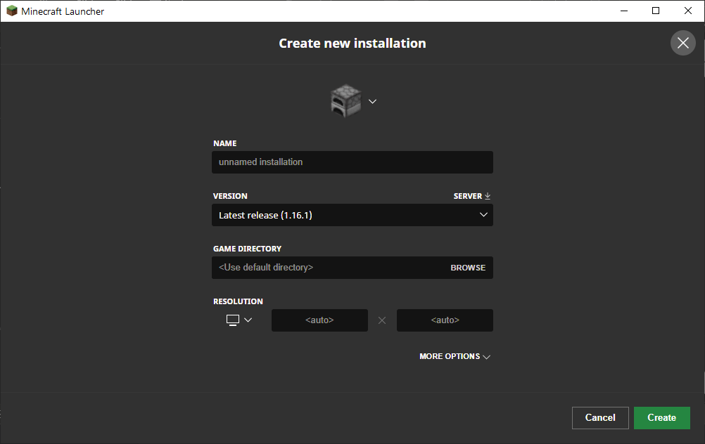
First Time Setup
You should now see a window similar to the one on the right.
Change the version from ‘Latest release’ to ‘release 1.15.2’.
If you want you can change the name of your installation using the name field.
Next click the green ‘Create’ button in the bottom right.

Slide 15
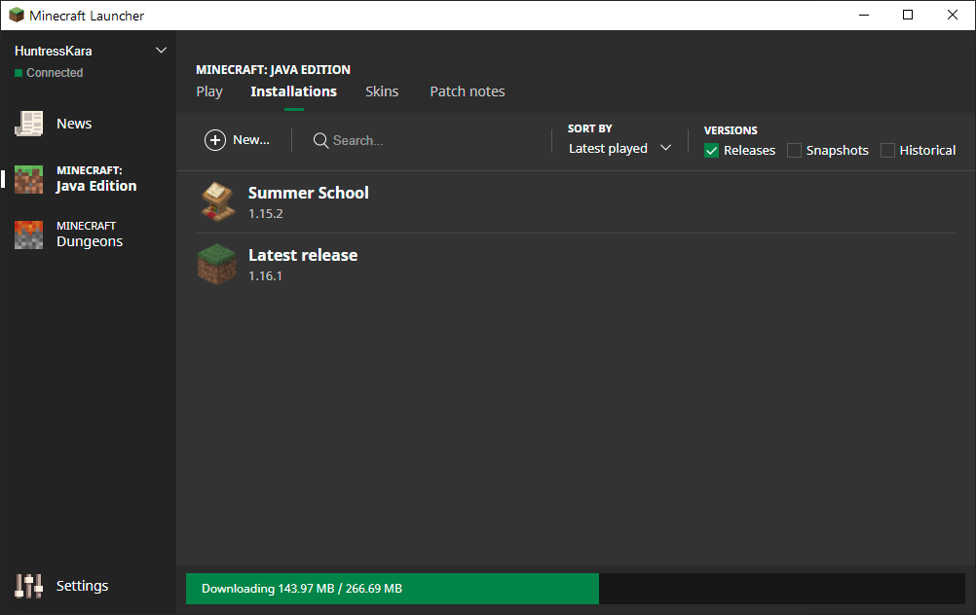
First Time Setup
Now you need to wait for the new installation to download.

Slide 16
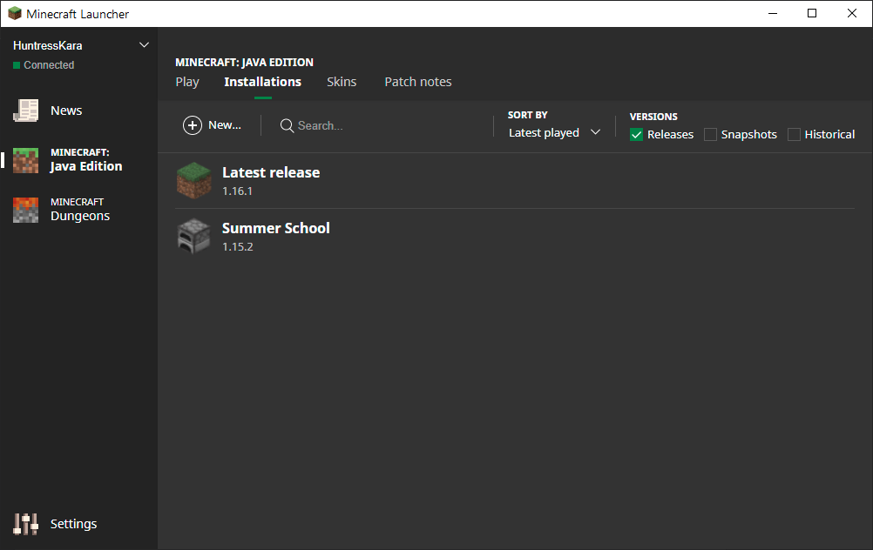
First Time Setup
Once your installation is downloaded, you should see a window similar to the one on the right.
Hovering over the installation will bring up a green ‘Play’ button.
Click on this button to start Minecraft.

Slide 17
Re-Opening Minecraft
Once you have completed your first time setup you should not need to repeat the process.
Instead, begin with opening the launcher as shown on slide 9.
You should see a window similar to the one shown on the next slide (you may need to log in first before you see this window).
Check the installation (shown in the bottom left hand corner) is the correct installation*.
Click on the green ‘Play’ button.
* If the correct installation is not shown you should be able to click on the ‘Installations’ tab and find the correct one. Hover over it and press the ‘Play’ button as shown in slide 16. If the correct installation does not appear repeat the steps from slide 11 onwards.

Slide 18
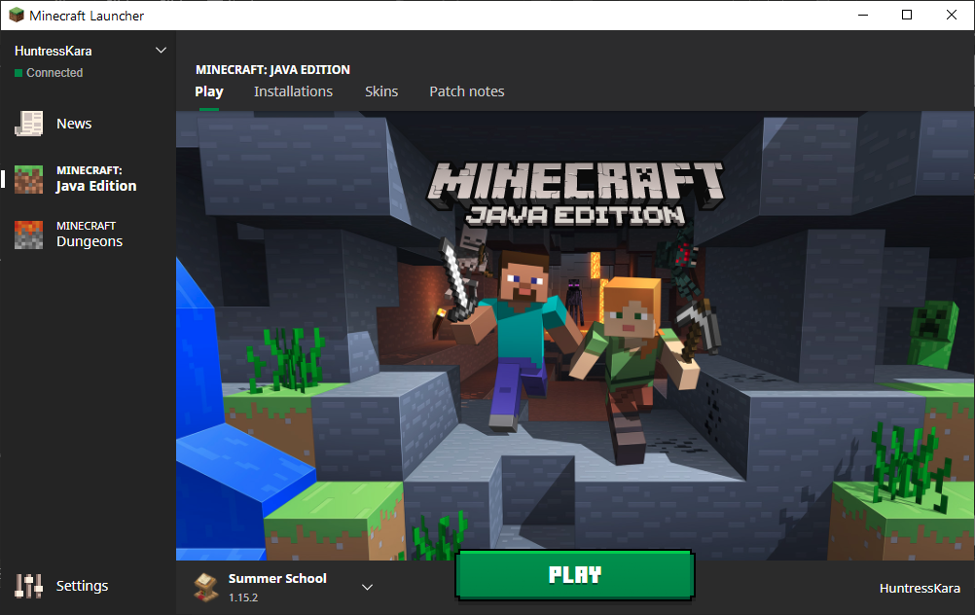

Slide 19
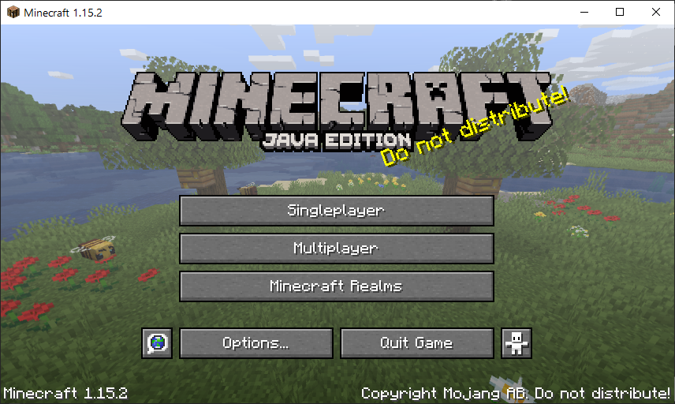
First Time Setup
Once you click play you should see a window similar to the one on the right.
You can click on the ‘Options...’ button to change the game settings such as turning the music off and changing the control scheme, and more.
You can click on the person button right of the ‘Quit Game’ button to access accessibility options such as showing subtitles, turning narrator on, and more.

Slide 20
Creating A World

Slide 21
Creating A World
From the Minecraft main menu, shown on the right hand side, select ‘Singleplayer’ to start creating a world.
On the next window select ‘Create New World’ in the bottom right.

Slide 22
Creating a World
From the Create New World window (see next slide) you have a number of options for customising your world.
First, you can name your world in the text box below ‘World Name’.
Second, you can select the game mode with the choices being ‘Creative’, ‘Survival’, and ‘Hardcore’.
In Creative mode you can create structures to your hearts content with any combination of blocks.
In Survival mode you must first mine a block before you can place that block. Blocks you can place will be limited to the blocks you have mined. Additionally, in Survival there may be enemies who can kill you and destroy your creations.
Hardcore mode is a harder version of survival mode.
Finally, you can access the ‘More World Options’ menu to further customise your world.

Slide 23
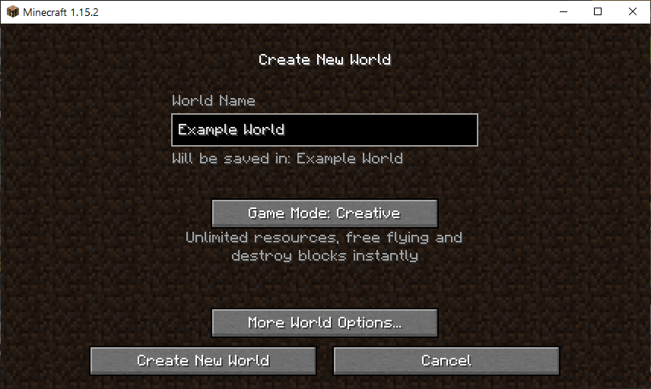

Slide 24
Creating a World
For the purposes of this guide we will be using a Creative world.
Once you have set the options for your world select ‘Create New World’ in the bottom left of the windows.
It will take a few seconds for Minecraft to construct your world.
Once this has finished you see a window similar to the one on the next slide.
Your world should look different to the one shown as Minecraft randomly creates a ‘unique’ world for you.

Slide 25
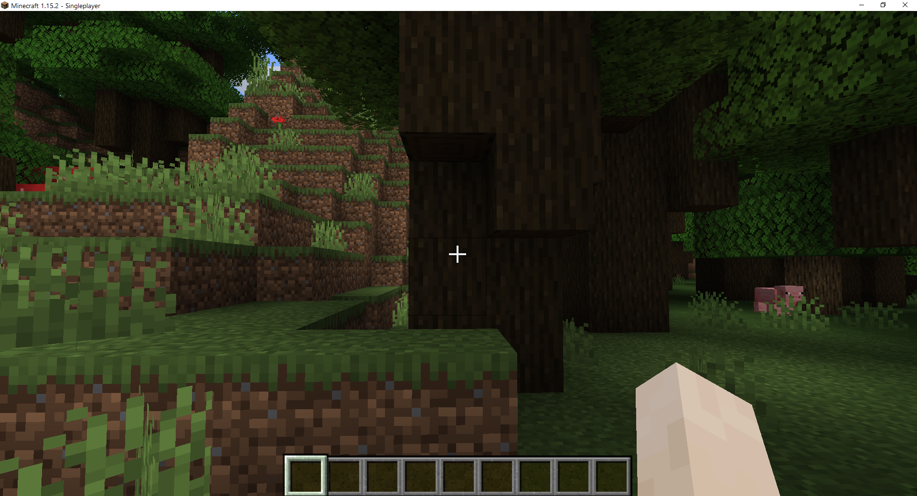

Slide 26
Controls

Slide 27
Controls - Movement
To move around the world use the ‘W’, ‘A’, ‘S’, and ‘D’ keys on your keyboard.
W will move your character forward
A will move your character left
S will move your character backwards
D will move your character right
Try moving around your world and see what you can find!

Slide 28
Controls - Movement
You can look around the world by moving your mouse.
You can also press the space bar to jump.
See if there any hills you can climb using the jump mechanic to get a better look at your world!

Slide 29
Controls - Mining
You can mine a block by clicking the left mouse button.
Your character will continue to mine for as long as you click the left mouse button and there is a block within range (up to 6 blocks away from your character).
Try and mine something close to you such as a tree.

Slide 30
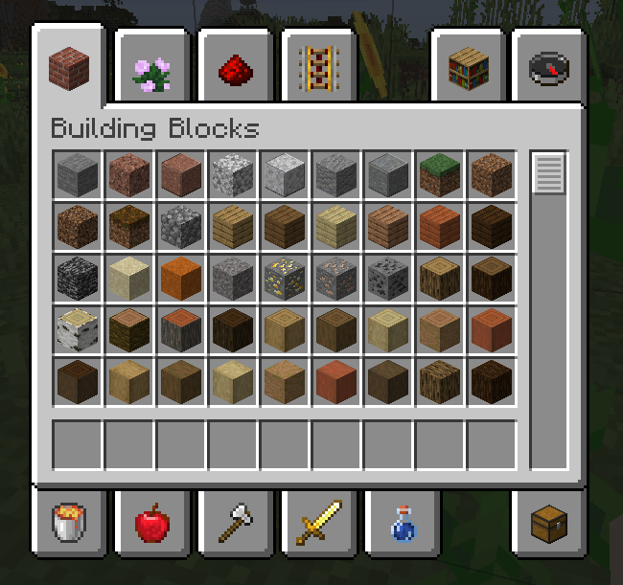
Controls - Building
To build something we first need to add a block from the inventory.
You can do this by opening the inventory menu with the ‘E’ key on your keyboard.
Select a block from the menu by clicking on it with the left mouse button.
Once you have selected a block move the cursor to one of the blank slots towards the bottom of the inventory menu and press the left mouse button again to add the block to this menu.
Now press the ‘E’ key again to exit the inventory.

Slide 31
Controls - Building
Adding a block to the bottom menu as described on the previous screen places the block in your ‘Quick Select Menu’ (QSM).
Your QSM consists of up to 9 blocks/items that you can quickly access whilst playing the game.
To access a block or item in your QSM press the numerical key associated with the block/items position in the menu.
For example, press ‘1’ for the item in the leftmost position of your QSM or ‘9’ for the item in the rightmost position.

Slide 32
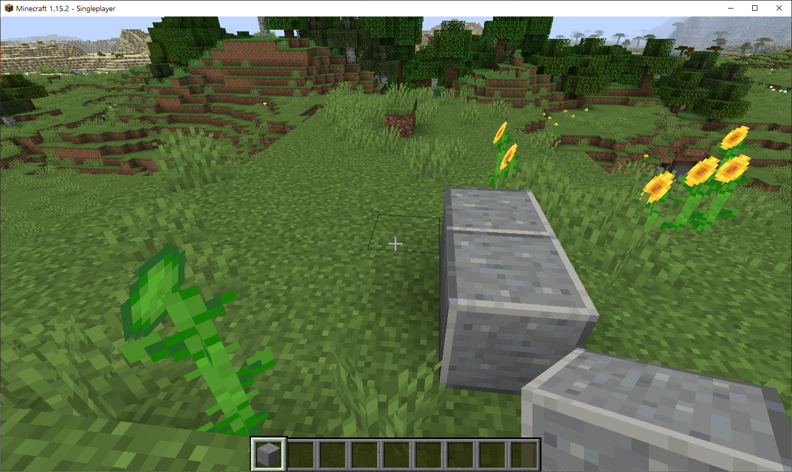
Basic Controls - Building
Once you have selected a block from your QSM using a numerical key, your character should be holding the block as shown in the image on the right.
Once your character is holding a block you can place that block by pressing the right mouse button.

Slide 33
Controls – Building
You can hold the right mouse button to continue to place blocks so long as the target location is in range and unobstructed.
You can combine movement with block placing to continually place blocks.
Experiment with different blocks from the inventory menu and the other controls you have learned so far to see what you can make.

Slide 34
Controls - Sprinting
You can sprint by quickly pressing ‘W’ twice in a row and holding ‘W’ on the second press.
Whilst sprinting you can move the mouse to change directions.
So long as you keep the ‘W’ key pressed you can jump whilst sprinting by also pressing the space bar.

Slide 35
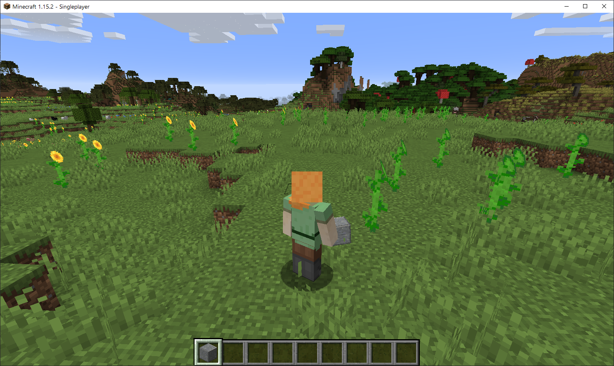
Controls – Changing Perspective
You can change perspective in the game by pressing ‘F5’.
This will allow you to see your character in 3rd person as shown in the image on the right.
Pressing ‘F5’ again will switch to front-facing 3rd person perspective.
Pressing ‘F5’ again will switch back to the original 1st person perspective.

Slide 36
Controls – Exiting the Game
To exit the game press the ‘ESC’ key (escape key) on your keyboard.
This will bring up the Game Menu from where you can view statistics, change the game’s options, and more.
To exit the game press the ‘Save and Quit to Title’ button at the bottom of the screen (see next slide).
For multiplayer games the button is ‘Disconnect’ instead of ‘Save and Quit to Title’.
Once you have returned to the main menu you can click on the ‘Quit Game’ button at the bottom right of the screen to close the game.

Slide 37
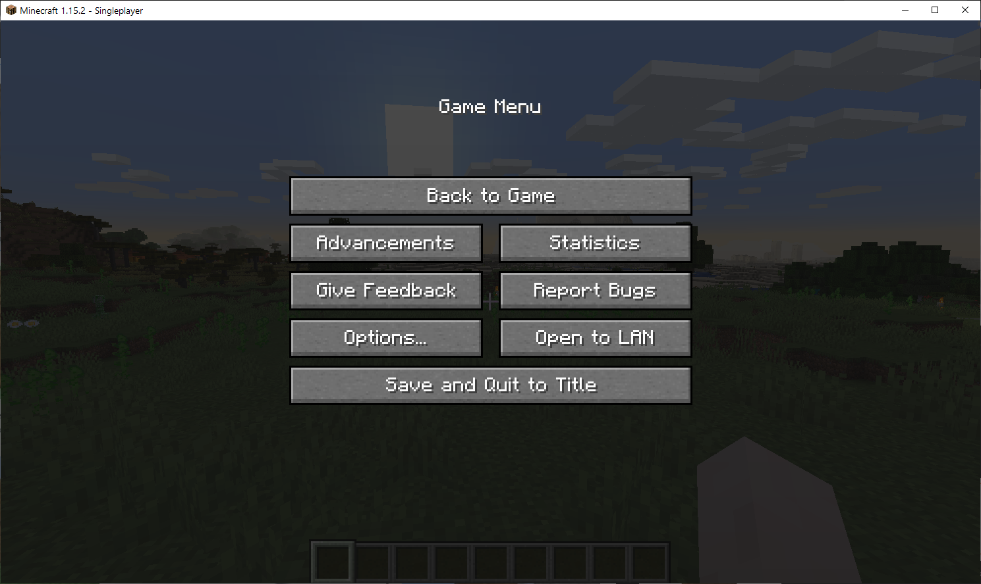

Slide 38
Basic Blocks

Slide 39
Basic Blocks – Building Blocks
Most of the blocks in the ‘Building Blocks’ section of the inventory function the same as each other in Creative mode*, differing only in visual appearance.
There are however, a few exceptions, discussed over the next few slides.
* In Survival and Hardcore mode blocks have a range of properties such as durability, time to mine etc.

Slide 40
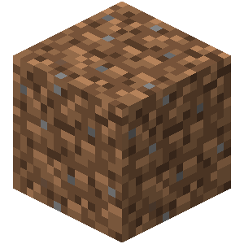
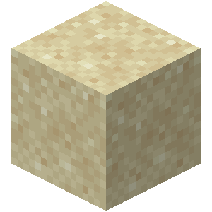
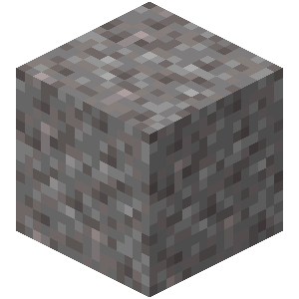
Basic Blocks - Gravity
Some blocks such as dirt, sand, and gravel can only be placed directly on top of another block or they will fall to the floor. This is not the case for most blocks.
Dirt Block
Sand Block
Gravel Block

Slide 41
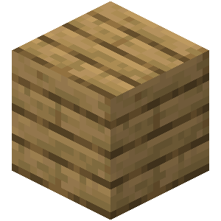
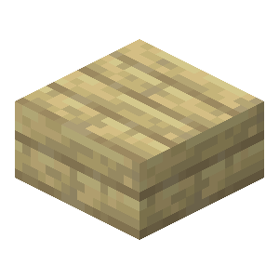
Basic Blocks - Slabs
Slabs are variants of most blocks that are half their height.
Slabs can be useful in creating certain structures and achieving certain ascetics.
Oak Plank
Birch Slab

Slide 42
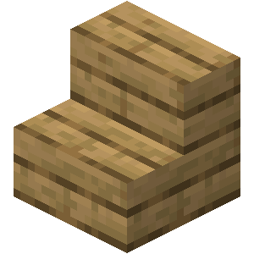
Basic Blocks - Stairs
In order to walk on top of most blocks your character needs to jump on top of these blocks.
To avoid jumping you can place stair blocks that your character can walk up.
Oak Stairs

Slide 43

Basic Blocks - Glass
Glass Blocks are unique blocks that are transparent, and thus let light through.
Just as you (probably) wouldn’t want to live in a house with no windows, it’s a good idea to include windows in buildings you create by using Glass Blocks.
Glass Block

Slide 44
Decoration Blocks

Slide 45
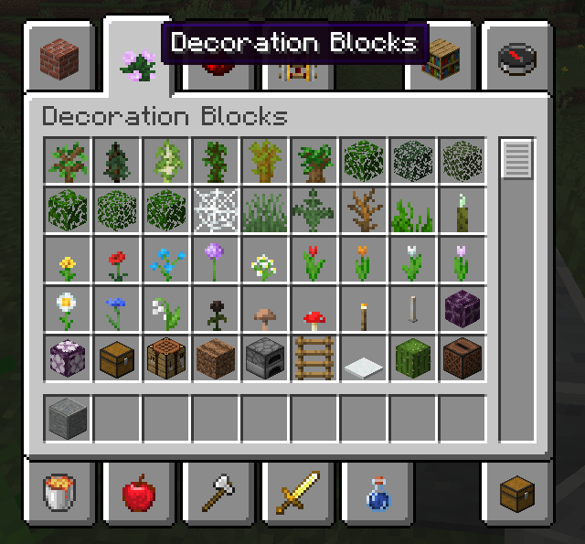
Decoration Blocks
Decoration Blocks can help add creative flair to your designs.
You can access Decoration Blocks from the Inventory Menu and selecting the second tab from the top-left as shown in the image on the right.

Slide 46
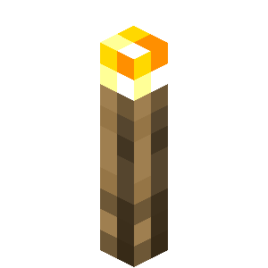
Decoration Blocks - Torch
Torches are special items that can be placed on top of or on the side of other blocks.
Once placed, a torch will light the surrounding area.
Torches are great for exploring dark places or lighting buildings during the night.
Torch

Slide 47
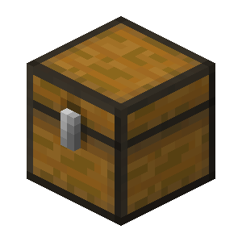
Decoration Blocks - Chests
Chests are special blocks that allow you to store items in them.
Once placed in the world you can access a chest by right clicking when looking at the chest.
Chest

Slide 48
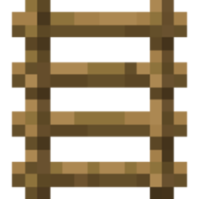
Decoration Blocks - Ladders
Ladders are special items that can be placed on the side of blocks.
Once placed ladders can be climbed by walking up to them and pressing ‘W’.
Ladder

Slide 49
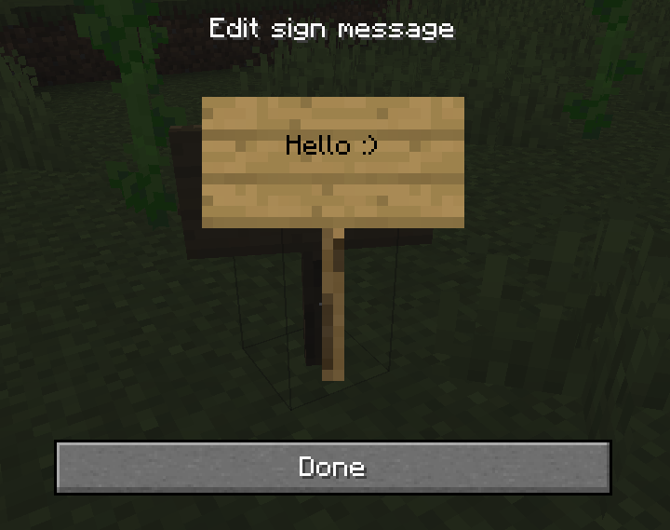
Decoration Blocks - Signs
Signs are special items that can be placed on top of or on the side of other blocks.
Once you place a sign, a menu will open that will allow you to customise the text on the sign.
If you notice that you made a mistake after closing the text editor, you can destroy the sign by clicking the left mouse button and then replace the sign with a new one.

Slide 50
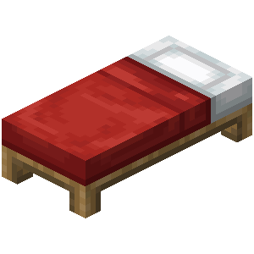
Decoration Blocks - Beds
Beds are special blocks that you can use to go to sleep to in the game.
To go to sleep right click when facing a bed.
You can only go to sleep during the night.
Bed

Slide 51
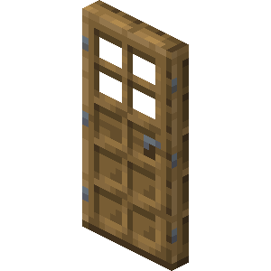
Other Blocks - Doors
Doors are special blocks that you can open and close.
To open or close a door, face it and press the right mouse button.
Oak Door

Slide 52
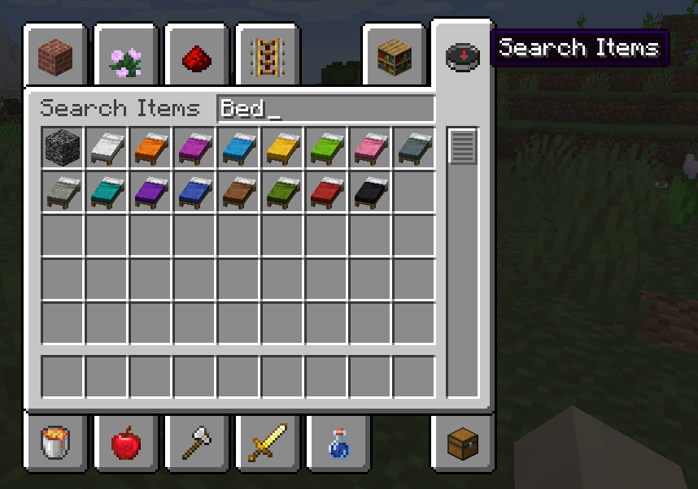
Finding Blocks
We’ve just scratched the surface of all the blocks that are in Minecraft.
Explore as many of the remaining blocks as you can and see if any of them do anything special!
If you are looking for a specific block you can click on the top-right-most tab of the inventory to access a search menu as shown in the image on the right.

Slide 53
Connecting to the Server

Slide 54
Connecting to the Server
From the Minecraft start menu shown on slide 19, click the ‘Multiplayer’ button.
The game may ask for network permissions which an Admin user will need to approve.
A disclaimer for online play may appear. You can proceed despite the warning knowing that the server we will be using has a strict code of conduct that everyone (including you) will have signed before being given access.

Slide 55
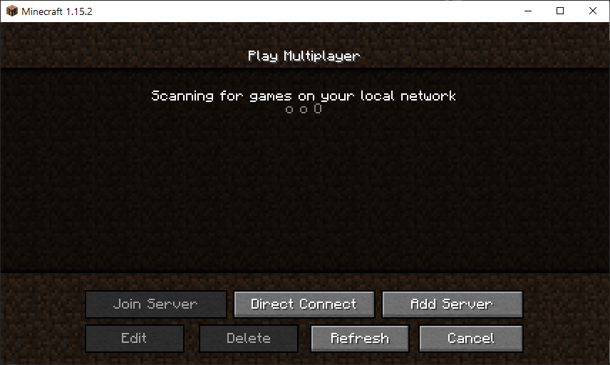
Connecting to the Server
You should see a window similar to the one shown on the right.
Click on the ‘Add Server’ button.
For the server name you can enter any name you would like.
For the server address enter 51.38.77.121:25565.
Click on the ‘Done’ button.

Slide 56
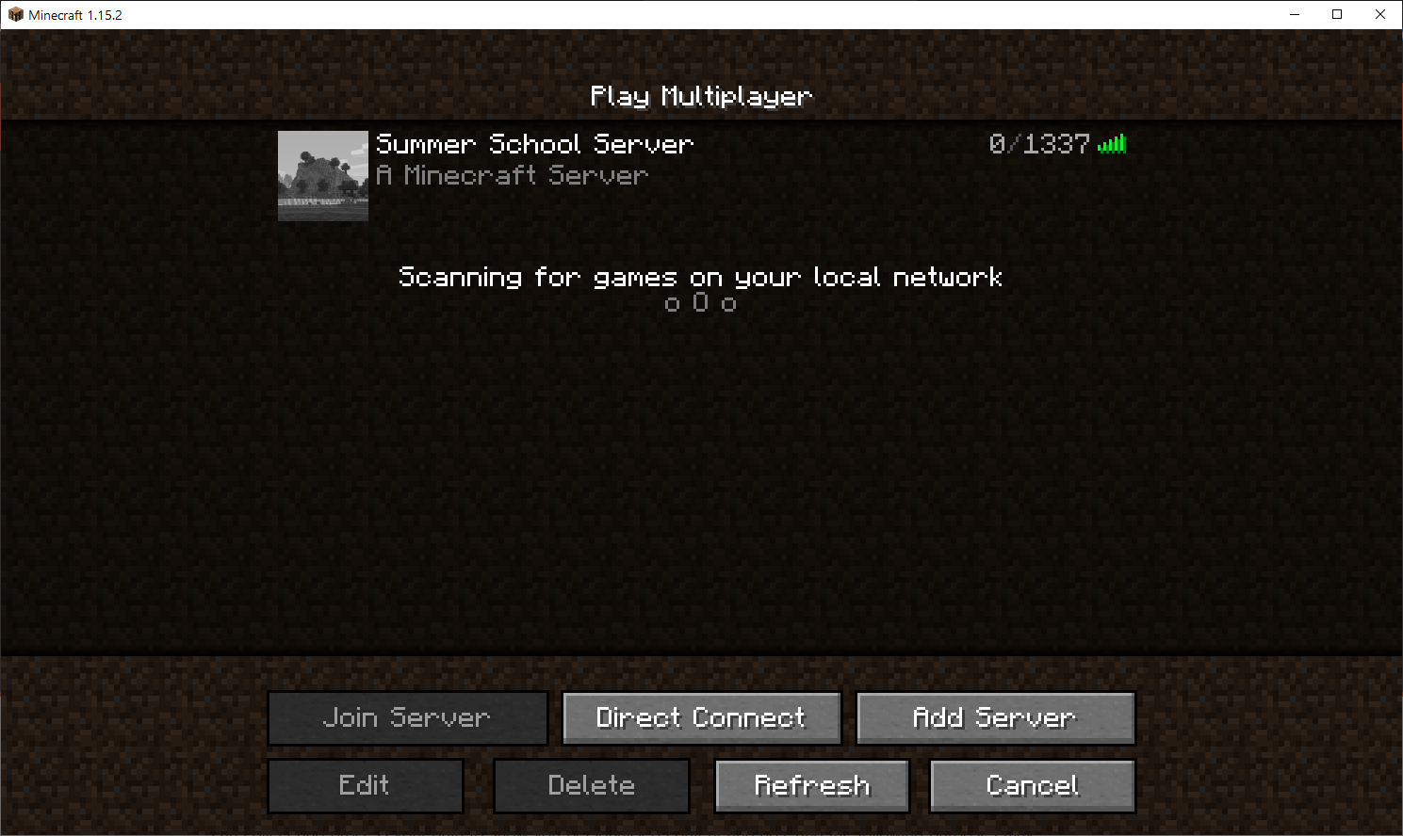
Connecting to the Server
The server should now appear on your list of servers as shown by the image on the right.
Hover over the server you created with the mouse and click on the Play button (a triangle) that appears.

Slide 57
Connecting to the Server
You may encounter an issue when attempting to connect to the server as shown on the following two slides.
There are periods when the server will be unavailable and thus it will be normal that you can’t access the server.
Try connecting again when you know the server will be available e.g. during the Minecraft sessions of the festival.
If you still can’t connect to the server please contact a Student Ambassador or Staff Member via Aula and let them about the the issues you are experiencing.

Slide 58
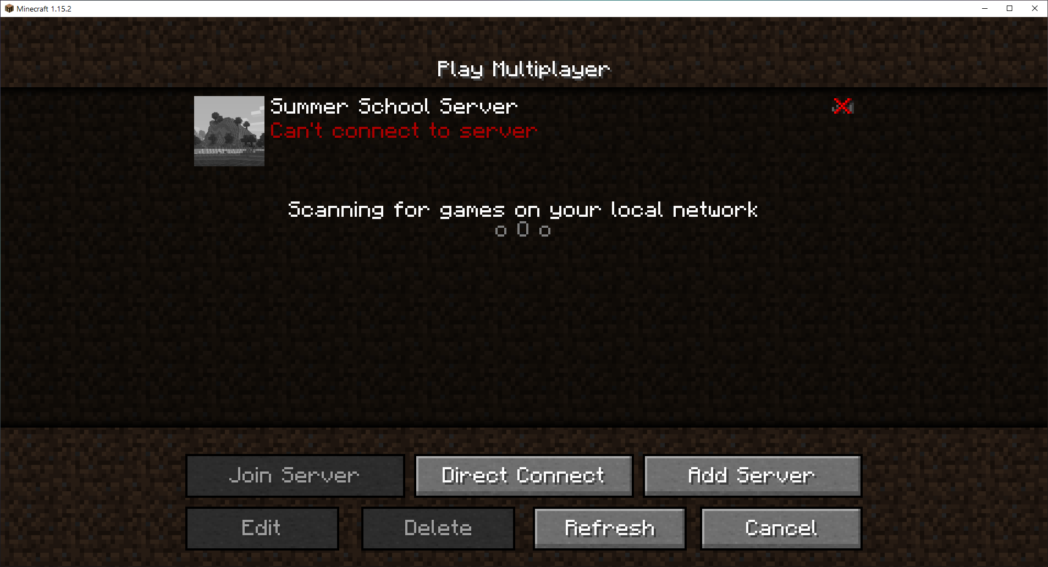

Slide 59
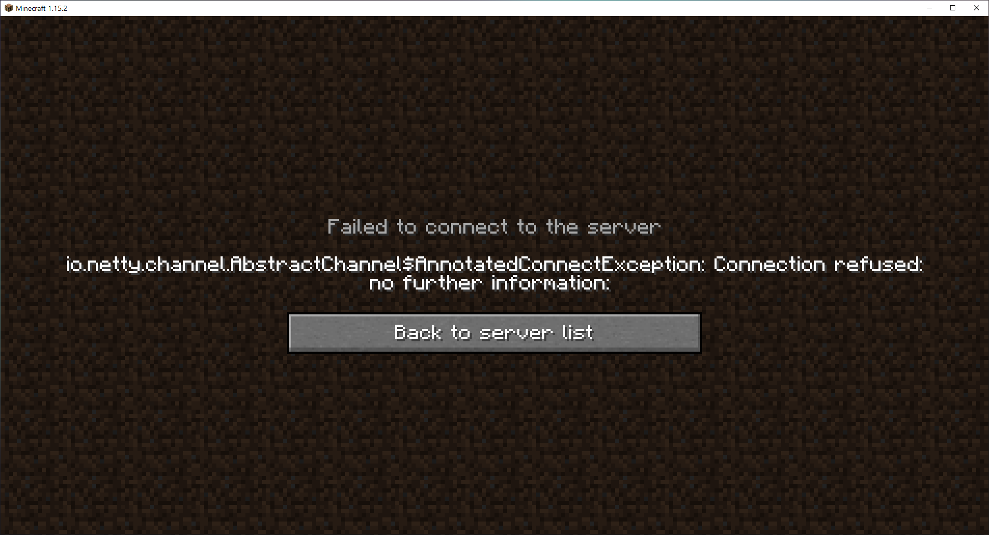

Slide 60
Using In-Game Chat

Slide 61
In-Game Chat
Minecraft has an in-game chat that you can use to communicate with other players.
Chat is only available in multiplayer games.
When in a multiplayer game press the ‘T’ key on your keyboard to open the chat menu.
Once opened you can type the message that you would like to send.
Once you are happy with the message press the ‘Enter’ key to send the message (see the next slide).

Slide 62
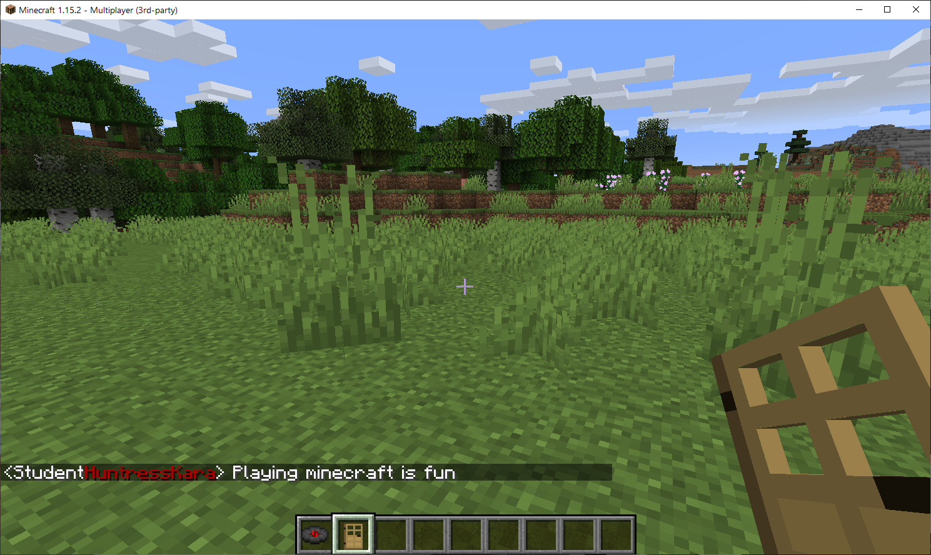

Slide 63
In-Game Chat
The message you send will be visible to all players currently playing the game.
The messages you write in chat should always be clean and respectful.

Slide 64
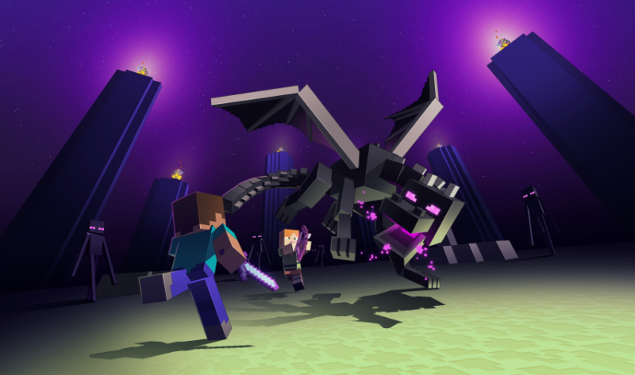
The End
If you have any questions feel free to ask Student Ambassadors or Members of Staff.

